Slide 1
Exam on Friday
Bring a scantron.
It will be similar to the midterm
It will include questions very similar to the Kung Fu Fight quiz
No class on Wed. Instead, I will hold a long office “hour”, from 8:30 to 10:30, to answer any last minute questions

Slide 2
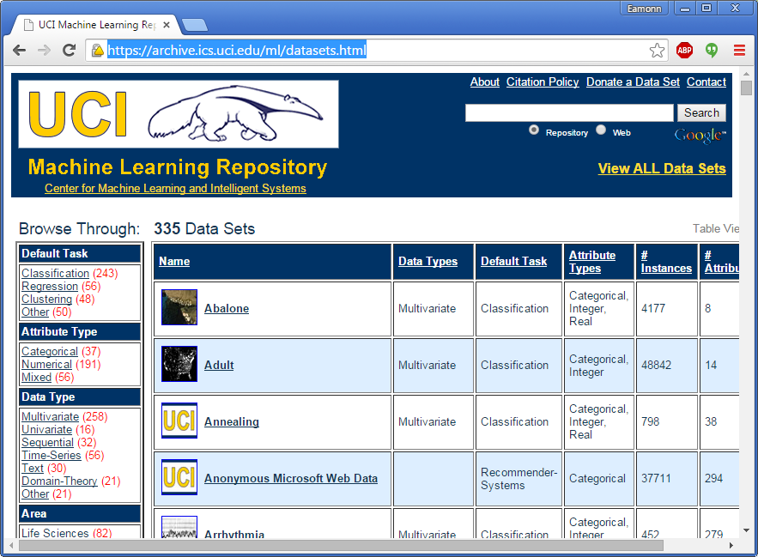
Extra Credit Possibility
https://archive.ics.uci.edu/ml/datasets.html
Also do search on a UCI dataset, and explain why the result is intuitive.
Don’t do this, unless the rest of your project is perfect!

Slide 3


Slide 4
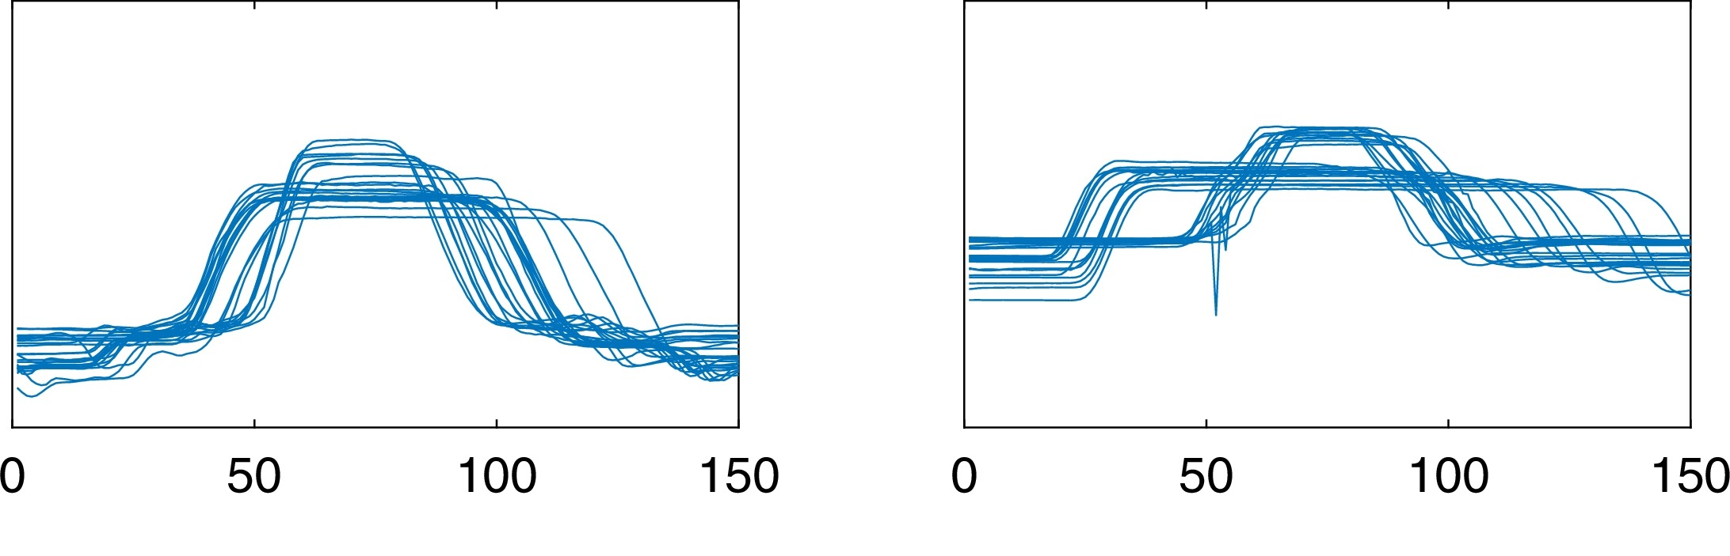
Examples of Gun
Examples of Point
Loc 48 | Loc 149 | Loc 150 | Class
8.0 | 1.9 | 6.1 | Gun
0.9 | 6.6 | 0.5 | Point
1.1 | 1.0 | 8.3 | Gun
5.4 | 1.1 | 3.1 | Gun
2.9 | 5.4 | 8.5 | Point
6.1 | 2.9 | 1.9 | Gun
0.5 | 6.1 | 6.6 | Point
8.5 | 0.5 | 1.0 | Gun
1.9 | 8.3 | 6.6 | Point
2.3 | 8.1 | 4.7 | Point
Insect ID | Abdomen Length | Antennae Length | Insect Class
1 | 2.7 | 5.5 | Grasshopper
2 | 8.0 | 9.1 | Katydid
3 | 0.9 | 4.7 | Grasshopper
4 | 1.1 | 3.1 | Grasshopper
5 | 5.4 | 8.5 | Katydid
6 | 2.9 | 1.9 | Grasshopper
7 | 6.1 | 6.6 | Katydid
8 | 0.5 | 1.0 | Grasshopper
9 | 8.3 | 6.6 | Katydid
10 | 8.1 | 4.7 | Katydids

Slide 5
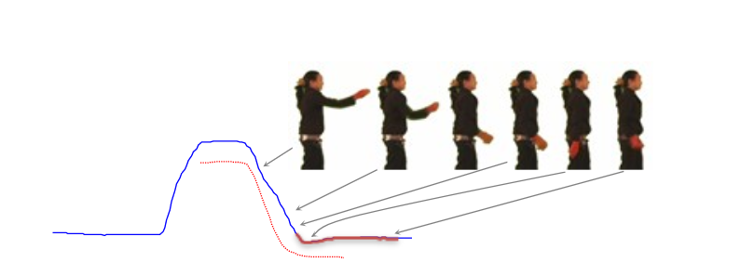
After Feature Search, we find the red highlighted features are most important, why?

Slide 6
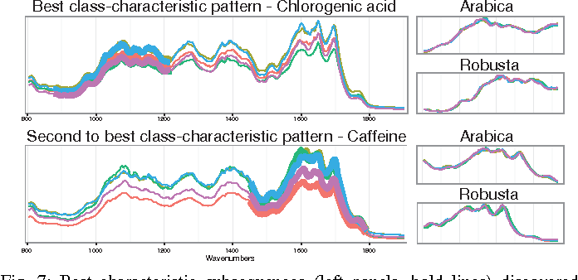
The Gun-Point example is silly, but the same idea can be used on coffee spectrographs….
Key Takeaway: Feature selection is not just about improving accuracy, it can sometimes tell you something you did not know.

Slide 7
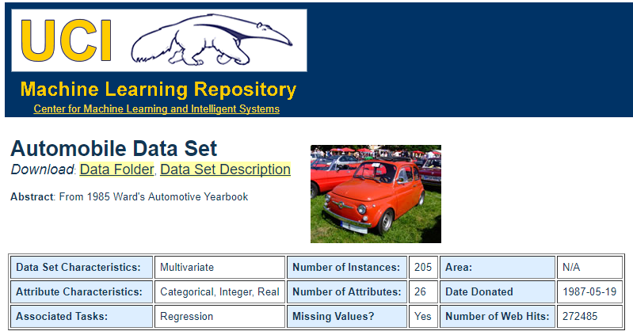
Extra Credit
Class assigned insurance risk rating
A value of +3 indicates that the auto is risky, -3 that it is probably pretty safe.
Features
3. make:
alfa-romero, audi, bmw, chevrolet, dodge, honda,
isuzu, jaguar, mazda, mercedes-benz, mercury,
mitsubishi, nissan, peugot, plymouth, porsche,
renault, saab, subaru, toyota, volkswagen, volvo
4. fuel-type: diesel, gas.
5. aspiration: std, turbo.
6. num-of-doors: four, two.
7. body-style: hardtop, wagon, sedan, hatchback, convertible.
8. drive-wheels: 4wd, fwd, rwd.
9. engine-location: front, rear.
10. wheel-base: continuous from 86.6 120.9.
11. length: continuous from 141.1 to 208.1.
12. width: continuous from 60.3 to 72.3.
13. height: continuous from 47.8 to 59.8.
14. curb-weight: continuous from 1488 to 4066.
15. engine-type: dohc, dohcv, l, ohc, ohcf, ohcv, rotor.
16. num-of-cylinders: eight, five, four, six, three, twelve, two.
17. engine-size: continuous from 61 to 326.
18. fuel-system: 1bbl, 2bbl, 4bbl, idi, mfi, mpfi, spdi, spfi.
19. bore: continuous from 2.54 to 3.94.
20. stroke: continuous from 2.07 to 4.17.
21. compression-ratio: continuous from 7 to 23.
22. horsepower: continuous from 48 to 288.
23. peak-rpm: continuous from 4150 to 6600.
24. city-mpg: continuous from 13 to 49.
25. highway-mpg: continuous from 16 to 54.
26. price: continuous from 5118 to 45400.
Go to the UCI Archive
Download a dataset, ideally one for which you have some knowledge.
Run feature search
Write an explanation as to why you think some features are selected, and/or why some features are dropped. For example
The number of doors was selected as a good feature. This makes sense, becase 2-door cars tend to be sports cars, and 4-doors tend to be family cars. Sports cars are bigger insurance risk.
The horsepower was also selected, this makes sense because powerful engines suggest…

Slide 8
Useful Trick
Sometimes it is useful to remap class labels and/or features.
For example. Here the class was originally seven valued, from -3 to 3. But I remapped it to a three class problem {-3,-2,-1} {0} {1, 2, 3}
Here there are 20 possible values for make, I remapped them to 2 classes {foreign} {USA}
Likewise, if you have some ideas or domain knowledge, you can process the data anyway you want. For example, maybe replacing the horsepower with the log of the horsepower.
Class assigned insurance risk rating
A value of +3 indicates that the auto is risky, -3 that it is probably pretty safe.
Features
3. make:
alfa-romero, audi, bmw, chevrolet, dodge, honda,
isuzu, jaguar, mazda, mercedes-benz, mercury,
mitsubishi, nissan, peugot, plymouth, porsche,
renault, saab, subaru, toyota, volkswagen, volvo
4. fuel-type: diesel, gas.
5. aspiration: std, turbo.
6. num-of-doors: four, two.
7. body-style: hardtop, wagon, sedan, hatchback, convertible.
8. drive-wheels: 4wd, fwd, rwd.
9. engine-location: front, rear.
10. wheel-base: continuous from 86.6 120.9.
11. length: continuous from 141.1 to 208.1.
12. width: continuous from 60.3 to 72.3.
13. height: continuous from 47.8 to 59.8.
14. curb-weight: continuous from 1488 to 4066.
15. engine-type: dohc, dohcv, l, ohc, ohcf, ohcv, rotor.
16. num-of-cylinders: eight, five, four, six, three, twelve, two.
17. engine-size: continuous from 61 to 326.
18. fuel-system: 1bbl, 2bbl, 4bbl, idi, mfi, mpfi, spdi, spfi.
19. bore: continuous from 2.54 to 3.94.
20. stroke: continuous from 2.07 to 4.17.
21. compression-ratio: continuous from 7 to 23.
22. horsepower: continuous from 48 to 288.
23. peak-rpm: continuous from 4150 to 6600.
24. city-mpg: continuous from 13 to 49.
25. highway-mpg: continuous from 16 to 54.
26. price: continuous from 5118 to 45400.

Slide 9
Important
For many datasets, you will probably need to normalize the features first.
For each column..
X= X-mean(X)/STD(X)
Or
X= X – min(X)
X = X /max(X)
Class assigned insurance risk rating
A value of +3 indicates that the auto is risky, -3 that it is probably pretty safe.
Features
3. make:
alfa-romero, audi, bmw, chevrolet, dodge, honda,
isuzu, jaguar, mazda, mercedes-benz, mercury,
mitsubishi, nissan, peugot, plymouth, porsche,
renault, saab, subaru, toyota, volkswagen, volvo
4. fuel-type: diesel, gas.
5. aspiration: std, turbo.
6. num-of-doors: four, two.
7. body-style: hardtop, wagon, sedan, hatchback, convertible.
8. drive-wheels: 4wd, fwd, rwd.
9. engine-location: front, rear.
10. wheel-base: continuous from 86.6 120.9.
11. length: continuous from 141.1 to 208.1.
12. width: continuous from 60.3 to 72.3.
13. height: continuous from 47.8 to 59.8.
14. curb-weight: continuous from 1488 to 4066.
15. engine-type: dohc, dohcv, l, ohc, ohcf, ohcv, rotor.
16. num-of-cylinders: eight, five, four, six, three, twelve, two.
17. engine-size: continuous from 61 to 326.
18. fuel-system: 1bbl, 2bbl, 4bbl, idi, mfi, mpfi, spdi, spfi.
19. bore: continuous from 2.54 to 3.94.
20. stroke: continuous from 2.07 to 4.17.
21. compression-ratio: continuous from 7 to 23.
22. horsepower: continuous from 48 to 288.
23. peak-rpm: continuous from 4150 to 6600.
24. city-mpg: continuous from 13 to 49.
25. highway-mpg: continuous from 16 to 54.
26. price: continuous from 5118 to 45400.

Slide 11











Two Types of Clustering
Partitional algorithms: Construct various partitions and then evaluate them by some criterion (we will see an example called BIRCH)
Hierarchical algorithms: Create a hierarchical decomposition of the set of objects using some criterion
Hierarchical
Partitional

Slide 12







Partitional Clustering
Nonhierarchical, each instance is placed in exactly one of K nonoverlapping clusters.
Since only one set of clusters is output, the user normally has to input the desired number of clusters K.

Slide 13
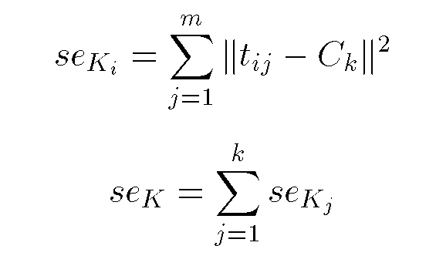
Squared Error
10
9
8
7
6
5
4
3
2
1
1
2
3
4
5
6
7
8
9
10
Objective Function

Slide 14
Algorithm k-means
1. Decide on a value for k.
2. Initialize the k cluster centers (randomly, if necessary).
3. Decide the class memberships of the N objects by assigning them to the nearest cluster center.
4. Re-estimate the k cluster centers, by assuming the memberships found above are correct.
5. If none of the N objects changed membership in the last iteration, exit. Otherwise goto 3.

Slide 15
K-means Clustering: Step 1
Algorithm: k-means, Distance Metric: Euclidean Distance
5
4
k₁
3
k₂
2
1
k₃
0
0
1
2
3
4
5

Slide 16
K-means Clustering: Step 2
Algorithm: k-means, Distance Metric: Euclidean Distance
5
4
k₁
3
k₂
2
1
k₃
0
0
1
2
3
4
5

Slide 17
K-means Clustering: Step 3
Algorithm: k-means, Distance Metric: Euclidean Distance
5
4
k₁
3
2
k₃
k₂
1
0
0
1
2
3
4
5

Slide 18
K-means Clustering: Step 4
Algorithm: k-means, Distance Metric: Euclidean Distance
5
4
k₁
3
2
k₃
k₂
1
0
0
1
2
3
4
5

Slide 19
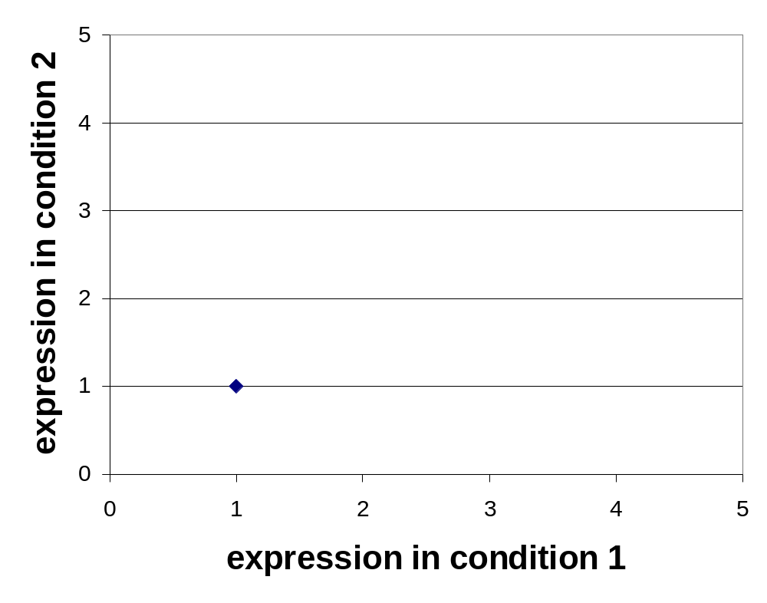
K-means Clustering: Step 5
Algorithm: k-means, Distance Metric: Euclidean Distance
k₁
k₂
k₃

Slide 20
http://mlehman.github.io/kmeans-javascript/

Slide 21
Comments on the K-Means Method
Strength
  Relatively efficient: O(tkn), where n is # objects, k is # clusters, and t is # iterations. Normally, k, t << n.
  Often terminates at a local optimum. The global optimum may be found using techniques such as: deterministic annealing and genetic algorithms
Weakness
  Applicable only when mean is defined, then what about categorical data?
  Need to specify k, the number of clusters, in advance
  Unable to handle noisy data and outliers
  Not suitable to discover clusters with non-convex shapes

Slide 22
The K-Medoids Clustering Method
Find representative objects, called medoids, in clusters
PAM (Partitioning Around Medoids, 1987)
  starts from an initial set of medoids and iteratively replaces one of the medoids by one of the non-medoids if it improves the total distance of the resulting clustering
  PAM works effectively for small data sets, but does not scale well for large data sets

Slide 23
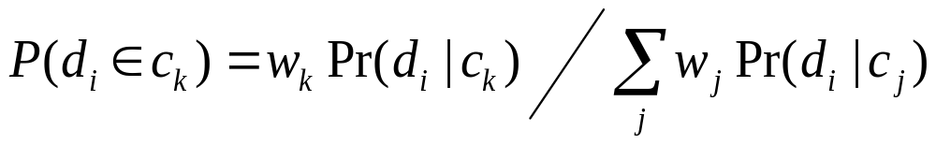
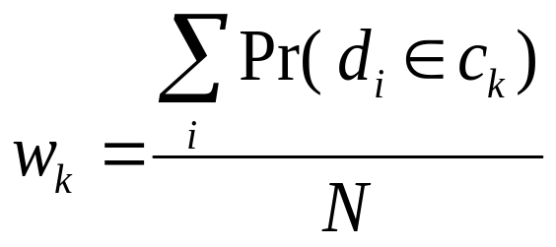
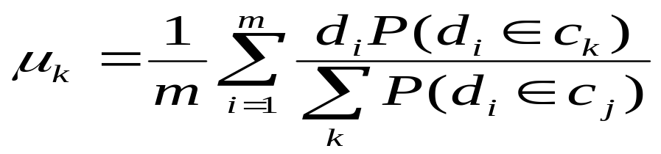
EM Algorithm
Initialize K cluster centers
Iterate between two steps
  Expectation step: assign points to clusters
  Maximation step: estimate model parameters

Slide 26
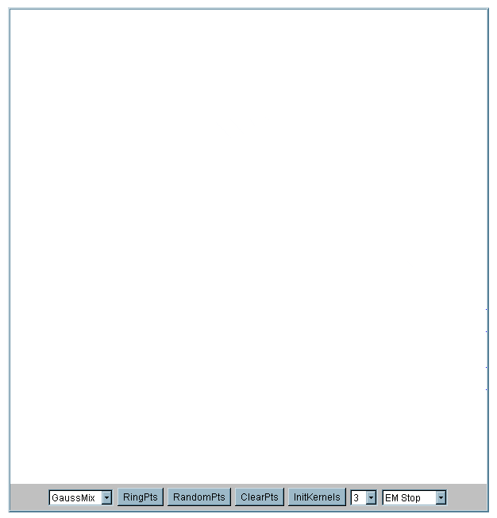
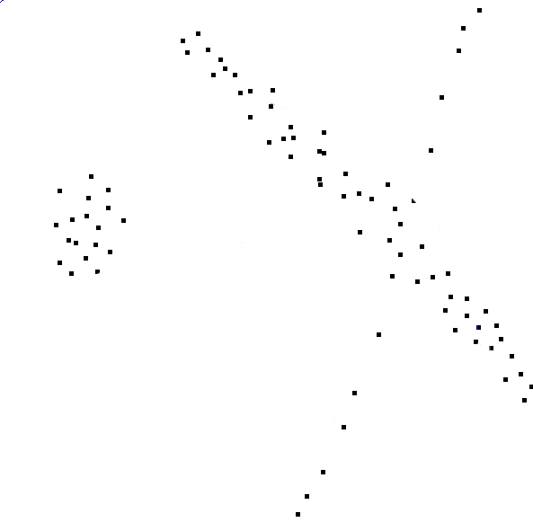

Slide 27
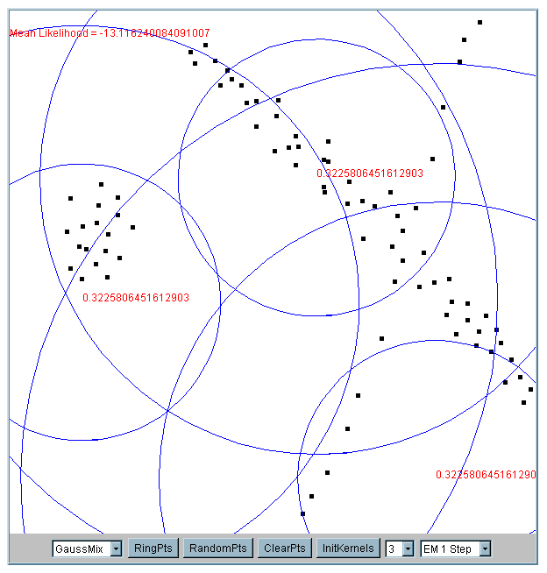
Iteration 1
The cluster means are randomly assigned

Slide 28
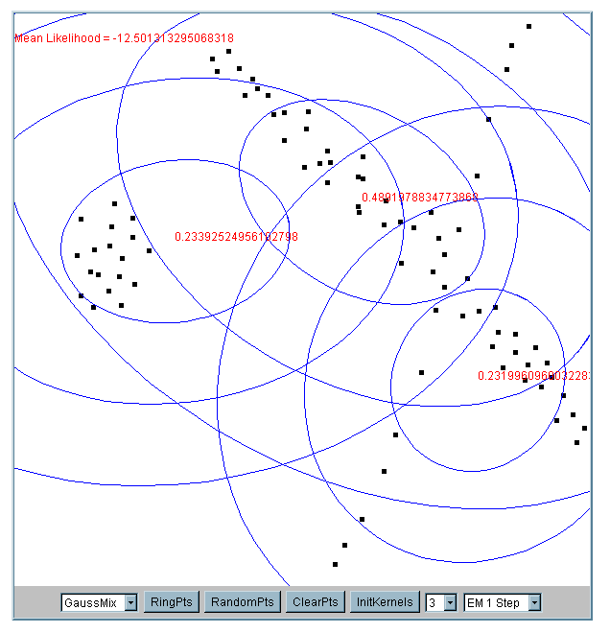
Iteration 2

Slide 29
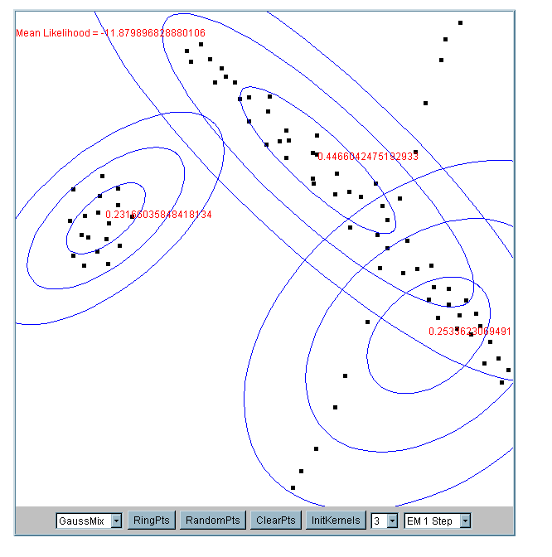
Iteration 5

Slide 30
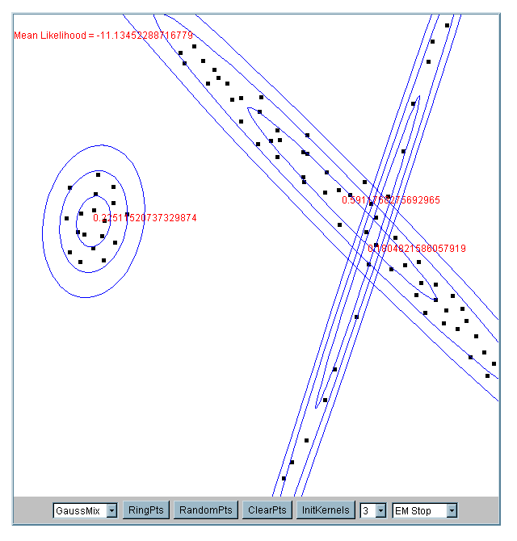
Iteration 25

Slide 31
What happens if the data is streaming…
Nearest Neighbor Clustering
Not to be confused with Nearest Neighbor Classification
Items are iteratively merged into the existing clusters that are closest.
Incremental
Threshold, t, used to determine if items are added to existing clusters or a new cluster is created.

Slide 32
10
9
8
7
Threshold t
6
5
4
3
1
t
2
1
2
1
2
3
4
5
6
7
8
9
10

Slide 33
10
9
8
7
6
New data point arrives…
It is within the threshold for cluster 1, so add it to the cluster, and update cluster center.
5
4
3
1
3
2
1
2
1
2
3
4
5
6
7
8
9
10

Slide 34
New data point arrives…
It is not within the threshold for cluster 1, so create a new cluster, and so on..
10
4
9
8
7
6
5
4
3
1
3
2
1
2
Algorithm is highly order dependent…
It is difficult to determine t in advance…
1
2
3
4
5
6
7
8
9
10

Slide 35
How can we tell the right number of clusters?
In general, this is a unsolved problem. However there are many approximate methods. In the next few slides we will see an example.
10
9
For our example, we will use the familiar katydid/grasshopper dataset.
However, in this case we are imagining that we do NOT know the class labels. We are only clustering on the X and Y axis values.
8
7
6
5
4
3
2
1
1
2
3
4
5
6
7
8
9
10

Slide 36
When k = 1, the objective function is 873.0
1
2
3
4
5
6
7
8
9
10

Slide 37
When k = 2, the objective function is 173.1
1
2
3
4
5
6
7
8
9
10

Slide 38
When k = 3, the objective function is 133.6
1
2
3
4
5
6
7
8
9
10

Slide 39
We can plot the objective function values for k equals 1 to 6…
The abrupt change at k = 2, is highly suggestive of two clusters in the data. This technique for determining the number of clusters is known as “knee finding” or “elbow finding”.
1.00E+03
9.00E+02
8.00E+02
7.00E+02
6.00E+02
Objective Function
5.00E+02
4.00E+02
3.00E+02
2.00E+02
1.00E+02
0.00E+00
k
1
2
3
4
5
6
Note that the results are not always as clear cut as in this toy example

